Slide 1


Christian Guerra
January 19 2022

Slide 2

Outline
Executive Summary
Introduction
Methodology
Results
Conclusion
Appendix

Slide 3
Executive Summary
This project has the purpose of predicting landing outcomes from Space X launches. Data is collected via an API and transformed for proper use.
An EDA is done to understand the data, select the relevant variables and have better insight on what information might be useful for the model. The table is transformed for a final model.
For Classification Models are used to predict the outcome: Logistic Regression, SVM, Decision Tree and K-Nearest Neighbors. All models have an accuracy of 83.33%, concluding that all are successful prediction methods.
The confusion matrix shows that the model inaccuracies are related to predicting false positives.

Slide 4
Introduction
The commercial age is here, each day space travel is becoming more affordable. The most accomplished company to this date has been SpaceX.
SpaceX has achieved lower costs due to the reuse of the first stage with the Falcon 9 rocket. If we could determine if the first stage will land we are able to determine the cost of the launch.
This project consists in determining the cost of a launch by using machine learning models to predict if SpaceX will reuse the first stage.

Slide 5


Slide 6
Methodology
Executive Summary
Data collection methodology:
Describe how data was collected
Perform data wrangling
Describe how data was processed
Perform exploratory data analysis (EDA) using visualization and SQL
Perform interactive visual analytics using Folium and Plotly Dash
Perform predictive analysis using classification models
How to build, tune, evaluate classification models

Slide 7
Data Collection
The first part consists in collecting data through the SpaceX API. Data is obtained through a JSON which is converted to a pandas Data Frame and cleaned afterwards so this information can be used for this project.
For this project data will also be collected through Web Scraping the SpaceX Wikipedia page to obtain the same Data Frame than the one obtained through the API.
This information will include information about which rocket was used, payload delivered, launch specification, landing specifications and landing outcome.

Slide 8
Data Collection – SpaceX API
The Following link could be used to see the complete notebook: Lab 1: Data Collection with API.
Import Libraries and Define Auxiliary Functions
We import requests to make HTTP requests to obtain data. We define a series of functions to extract information from the API using ID numbers.
Using a GET request and decoding the JSON response we convert the data to a pandas Data Frame. We format columns correctly.
Obtaining Data Frame
Make additional Requests and Parse Data
We use the getBoosterVersion() function to obtain booster versión from the rocket ID. getLaunchSite(), getPayloadData() and getCoreData() are also used to obtain the launch site, payload and core data. The Final Data Set is created.

Slide 9
Data Collection - Scraping
The Following link could be used to see the complete notebook: Lab 2: Data Collection with Web Scraping.
Import Libraries and Define Functions
We use BeautifulSoup to extract Falcon 9 launches from wikipedia via Web Scraping. Helper functions are defined to facilitate the parsing process.
Request Data From URL
Extract Column Names
Create Data Frame via Parsing
Using the html GET method we request the Falcon9 launch HTML page as an HTTP Response and create a BeautifulSoup object.
We find all tables on the wiki page using BeautifulSoup, we select the third table, we iterate through the <th> elements that are the column names and append to a list.
We create a dictionary with extracted column names. We create a pandas Data Frame. We loop through the tables and obtain each row from the html tables for all of the columns previously extracted.

Slide 10
Data Wrangling
Here the data wrangling process is described, the complete notebook can be seen in the following link: Lab 3: Data Wrangling.
Initial EDA
This step was partially done in Lab 1 but is part of the Data Wrangling process. The Data Frame is Filtered to include only Falcon 9. We calculate the percentage of missing values per attribute. 40% of Landing Pad is missing. Payload Mass’s 5 missing instances were replaced to their mean in lab 1. We analize attribute data types.
We obtain the number of launches per launch site using the value_counts() method from the Launch Site attribute. There are three different locations: ‘CCAFS SLC 40’ (55), ‘KSC LC 39 A’ (22) and ‘VAFB SLC 4E’ (13). We obtain the Number of occurences per orbit, each launch aims to a dedicated orbit.
Creation of Classification Variable
Since we wish to predict landing outcomes we create a new ‘Class’ variable that has a value of 0 if the outcome was unsuccesful and 1 if succesful. This is done by using the information from the set of unsuccesful outcomes. We also now determine the success rate (66%).
Number of Launches and Occurence
Determine Landing Outcomes
We obtain the different landing outcomes, and create a set of the five that did not land succesfully.

Slide 11
EDA with Data Visualization
We explore, visualize and prepare data, the complete notebook can be seen in the following link: Lab 4: EDA with Visualization. Here are the list of charts displayed:
Flight Number: These charts provide information on different attributes and flight number. They also display the outcome:
Payload Mass: we wish to understand how the mass might affect the success outcome.
Launch Site: we wish to understand how different launch sights affect the success outcome.
Launch Site / Payload Mass: We observe if there is a relationship between launch sites and their payload mass.

Slide 12
EDA with Data Visualization
Orbit Type: we wish to analyze the effect of orbit type and the relation with other attributes:
Success Rate: how different orbit types have an effect on the success rate.
Flight Number: we see how orbit type and flight number are related.
Payload: we visualize how Payload mass is related to orbit type.
Launch Success Yearly Trend: we see how the success rate has varied throughout time.
The variables that might affect the success rate are selected and dummy variables are created for categorical columns. Now all relevant variables are numerical.

Slide 13
EDA with SQL
The Following Queries Where Performed:
Displaying the names of the unique launch sites in the space mission
Display 5 records where launch sites begin with the string’CCA’
Display the total payload mass carried by boosters launched by NASA (CRS)
Display average payload mass carried by booster version F9 v1.1
List the date when the first successful landing outcome in ground pad was acheived.
List the names of the boosters which have success in drone ship and have payload mass greater than 4000 but less than 6000
List the total number of successful and failure mission outcomes
List the names of the booster_versions which have carried the maximum payload mass. Use a subquery
List the failed landing_outcomes in drone ship, their booster versions, and launch site names for in year 2015
Rank the count of landing outcomes (such as Failure (drone ship) or Success (ground pad)) between the date 2010-06-04 and 2017-03-20, in descending order
The full notebook could be seen at: Lab 5: EDA With SQL.

Slide 14
Build an Interactive Map with Folium
Different objects are added to a map of the launch locations, the objects are the following:
Circles: To show the different launch locations.
Markers: To name launch locations, show successful and unsuccessful launches in each location with a cluster, write the distance from an object and a launch location.
Lines: To show a straight line from an object and its launch location (Ex. Highways, Railways, etc…).
Cursor: To display the latitude and longitude of the mouse in the map.
The complete notebook could be seen at: Lab 6: Locations Analysis with Folium

Slide 15
Build a Dashboard with Plotly Dash
Plotly Dash is used to create an interactive dashboard for data visualization. The use has given the option to select the location sites and the payload range that will be displayed.
A Pie Chart was added to understand the percentage of successful launches and a Scatter Plot was added to see the correlation between payload mass and success.
These options and charts will give the user a better understanding of behaviors of different locations and the influence that the booster version and payload mass affect the success of a launch.
The interactive dashboard can be seen here: Lab 7: Plotly Dashboard

Slide 16
Predictive Analysis (Classification)
Here the data Predictive Analysis process is described, the complete notebook can be seen in the following link: Lab 8: Predictive Analysis
Data Setup and Split
The data is separated in the dependent variable (y) and the independent variables (X). Afterwards X is normalized. Finally the set is split randomly for both X and y in a train and test set. The test set has a size of 20%.
4 models are tested to predict a success: Logistic Regression, Support Vector Machine (SVM), Decision Tree & K Nearest Neighbours. On all models a grid search is used to tune the hyperparameters and obtain the best accuracy for each model.
Executing Models
Comparing Models
All results are studied by reviewing accuracy and a confusion matrix. The best model is selected.

Slide 17
Results
Exploratory data analysis results
Interactive analytics demo in screenshots
Predictive analysis results

Slide 18


Slide 19
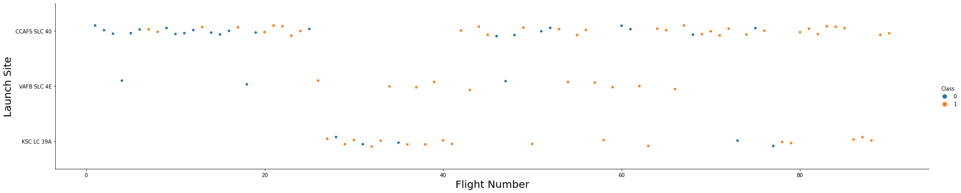
Flight Number vs. Launch Site
CCAFS SLC 40 seems to be the main launch site used
KSC LC 39 A seems to be used as a replacement for CCAFS SLC 40 launches
VAFB SLC 4E is rarely used
The success rate increases at higher flight numbers, after launch sixty the success rate grows nearer to 100%

Slide 20
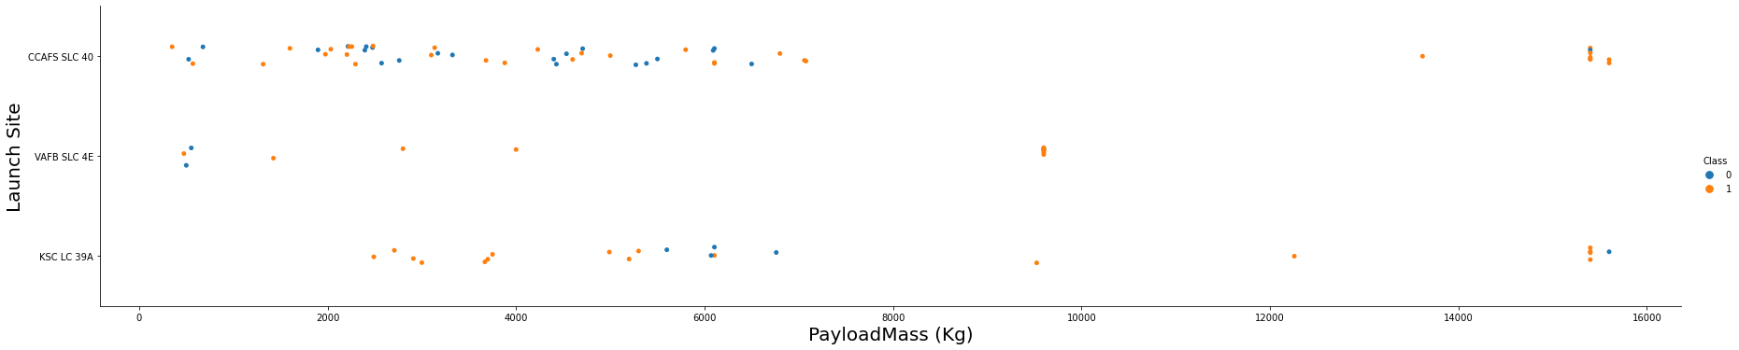
Payload vs. Launch Site
If you observe Payload Vs. Launch Site scatter point chart you will find for the VAFB-SLC launchsite there are no rockets launched for heavypayload mass (greater than 10000).

Slide 21
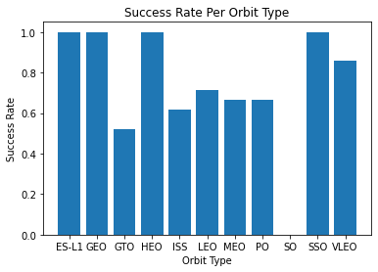
Success Rate vs. Orbit Type
The Success rate clearly varies per orbit type.
The most successful types are ES-L1, GEO, HEO and SSO with a success rate of 100%.

Slide 22
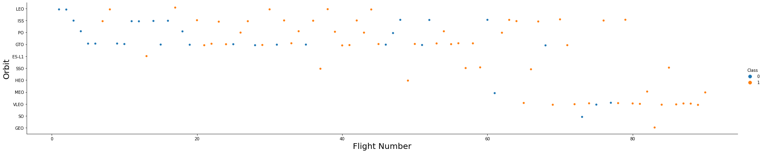
Flight Number vs. Orbit Type
You should see that in the LEO orbit the Success appears related to the number of flights; on the other hand, there seems to be no relationship between flight number when in GTO orbit.
The 4 orbits with 100% success have low number of flights that explain their success, yet VLEO that had a success rate above 80% has a higher amount of flights. It was also implemented after flight 60 and seems to be the prefered method from then on.

Slide 23
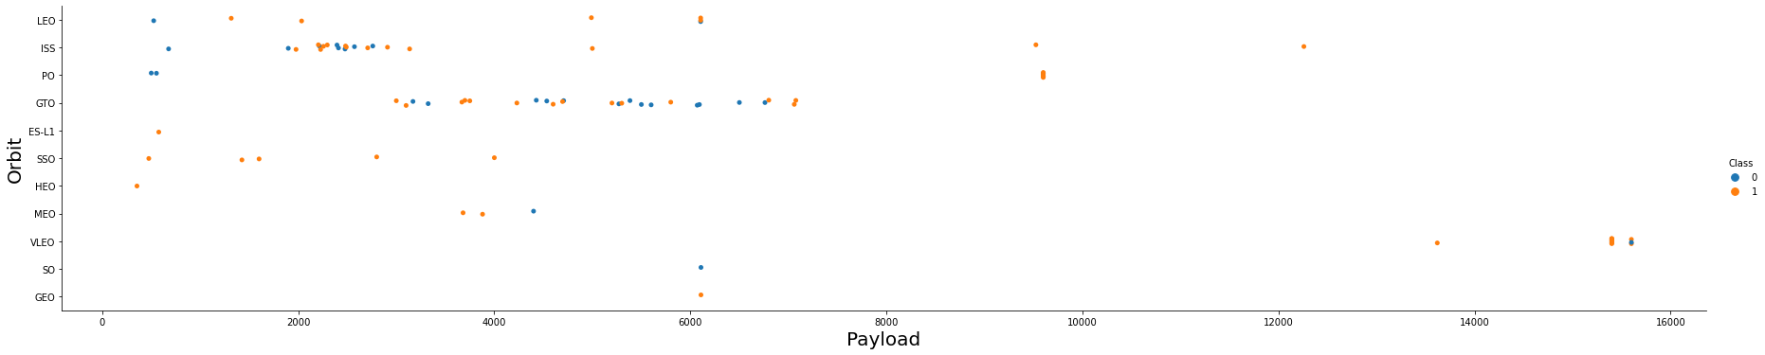
Payload vs. Orbit Type
With heavy payloads the successful landing or positive landing rate are more for Polar,LEO and ISS.
However for GTO we cannot distinguish this well as both positive landing rate and negative landing(unsuccessful mission) are both there here.

Slide 24
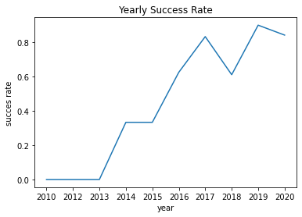
Launch Success Yearly Trend
You can observe that the sucess rate since 2013 kept increasing till 2020.

Slide 25
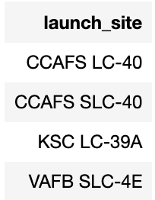
All Launch Site Names
The Following are all the Launch Sites and its query, we calculate it by grouping by launch site.

Slide 26
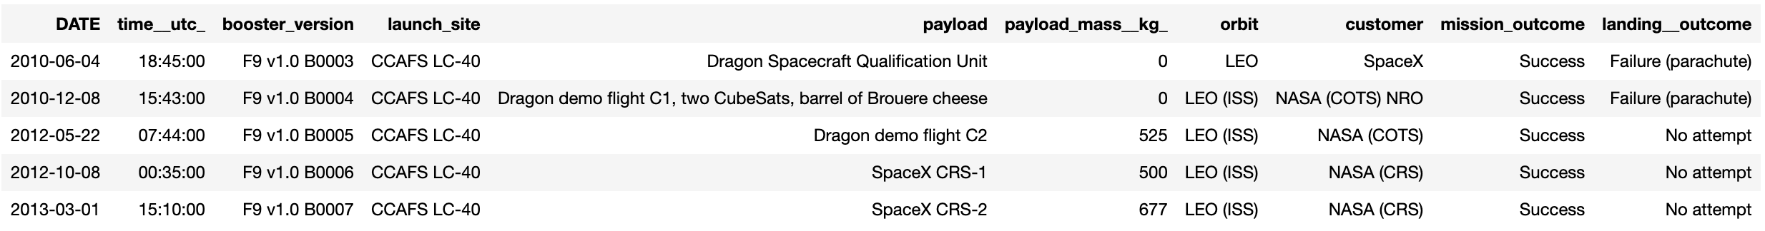
Launch Site Names Begin with 'CCA'
The Following are the first five Launch sites that begin with ’CCA’

Slide 27
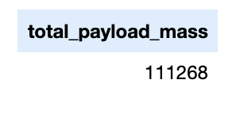
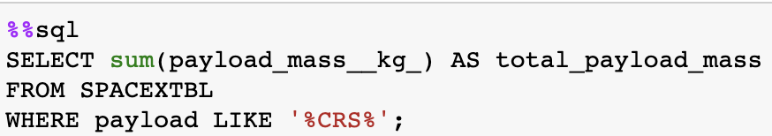
Total Payload Mass
The total payload mass by boosters launched by NASA is 111.268 kg.

Slide 28
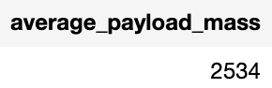
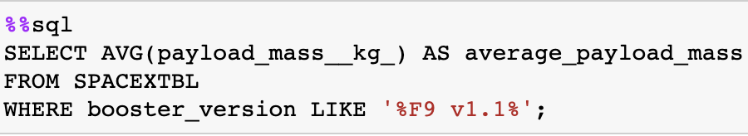
Average Payload Mass by F9 v1.1
We calculate the average payload mass carried by booster version F9 v1.1

Slide 29
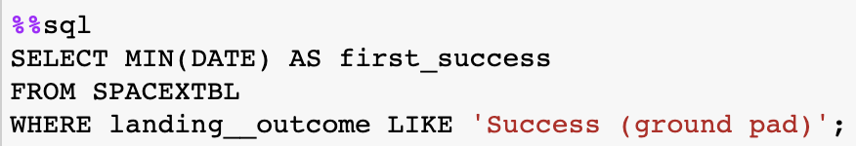
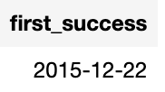
First Successful Ground Landing Date
This query is the date of the first successful landing outcome on the ground pad.
The first success for this type of landing was December 22, 2015.

Slide 30
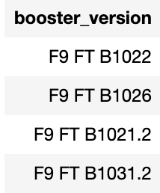
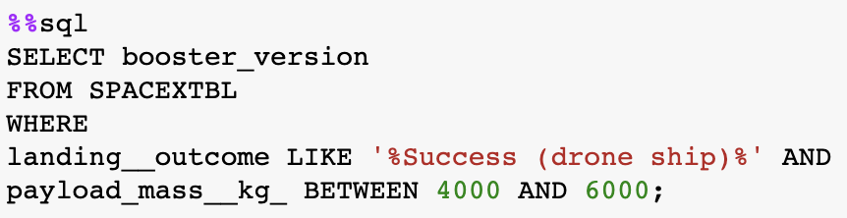
Successful Drone Ship Landing with Payload between 4000 and 6000
These are the boosters which have successfully landed on drone ship and had payload mass greater than 4000 but less than 6000.

Slide 31
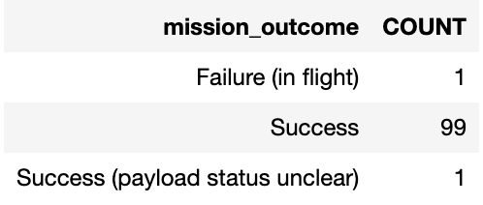
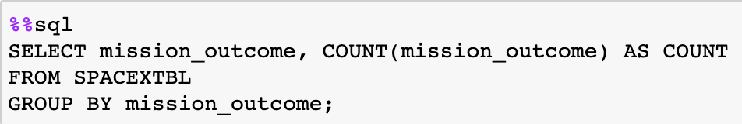
Total Number of Successful and Failure Mission Outcomes
This is the total number of successful and failure mission outcomes.

Slide 32
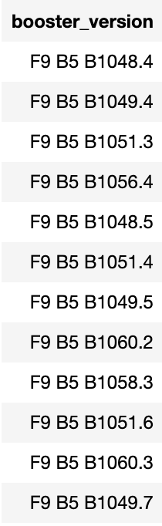
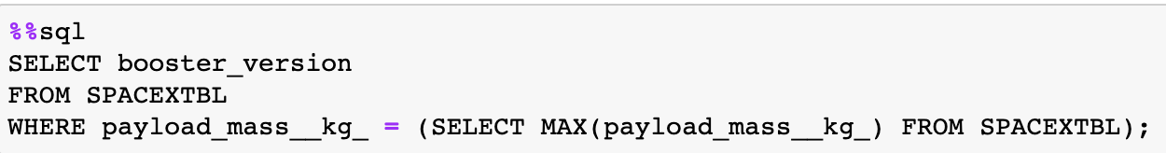
Boosters Carried Maximum Payload
Here are the names of the booster which have carried the maximum payload mass
A query is done inside of another query to obtain the maximum payload mass.

Slide 33
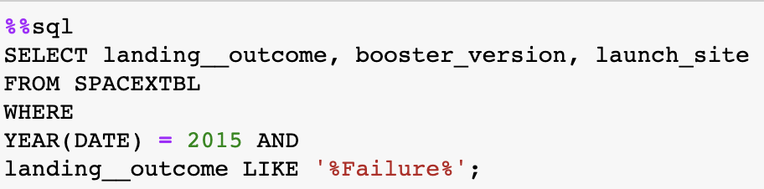
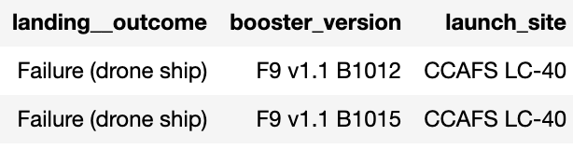
2015 Launch Records
These are de landing outcomes in drone ship, their booster versions, and launch site names for the year 2015.

Slide 34
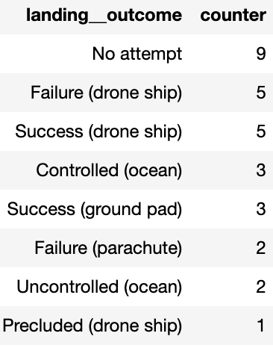
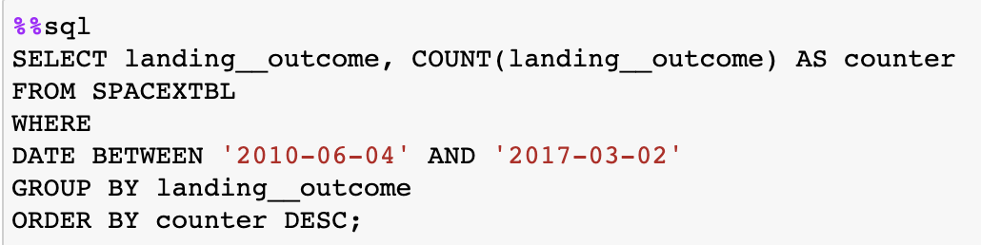
Rank Landing Outcomes Between 2010-06-04 and 2017-03-20
Here we rank the count of landing outcomes between the date 2010-06-04 and 2017-03-20, in descending order.

Slide 35


Slide 36
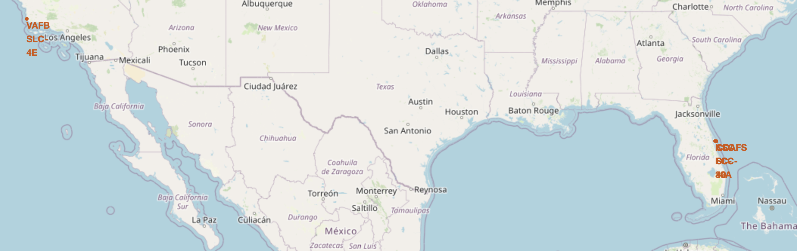
Space X Launch Sites
All Launch sites seem to be by the coast and somewhat close to the equator. Based on the previous EDA, Florida seems to be the location of choice for launch sites (CCAFS LC-40, CCAFS SLC-40 and LC-39A).
Notes:
CCAFS LC-4028.562302-80.5773561CCAFS SLC-4028.563197-80.5768202KSC LC-39A

Slide 37
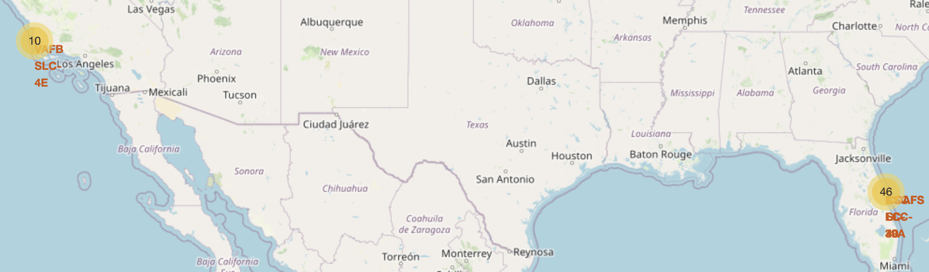
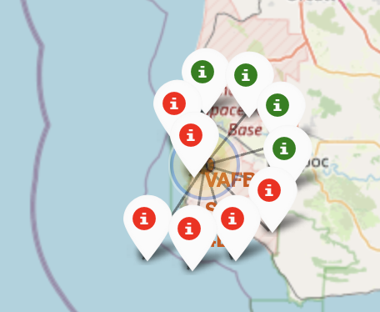
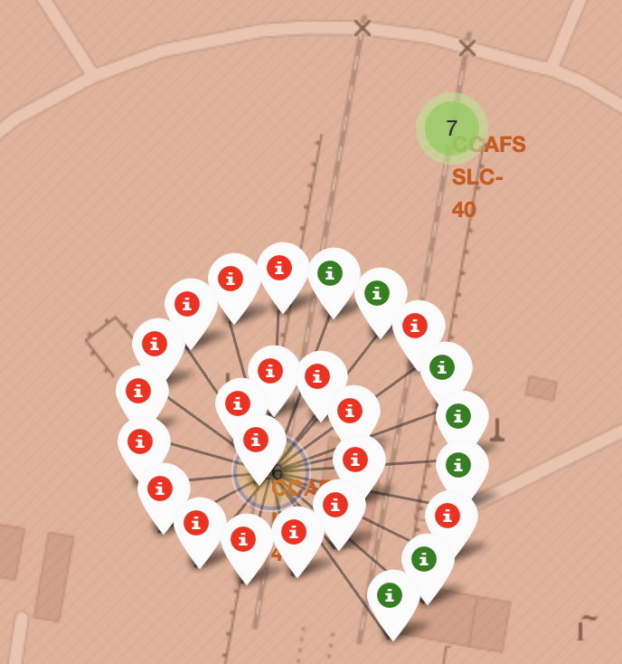
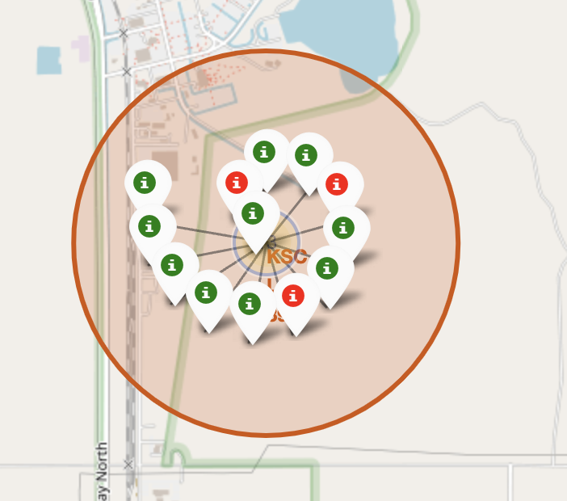
Success Rate Map per Location
We see that location KSC LC-39A, in Florida, has the highest success rate (lower right). The other two locations in Florida have lower success rates yet more launches (lower left) and the location in California also has a low success rate (upper rights).

Slide 38
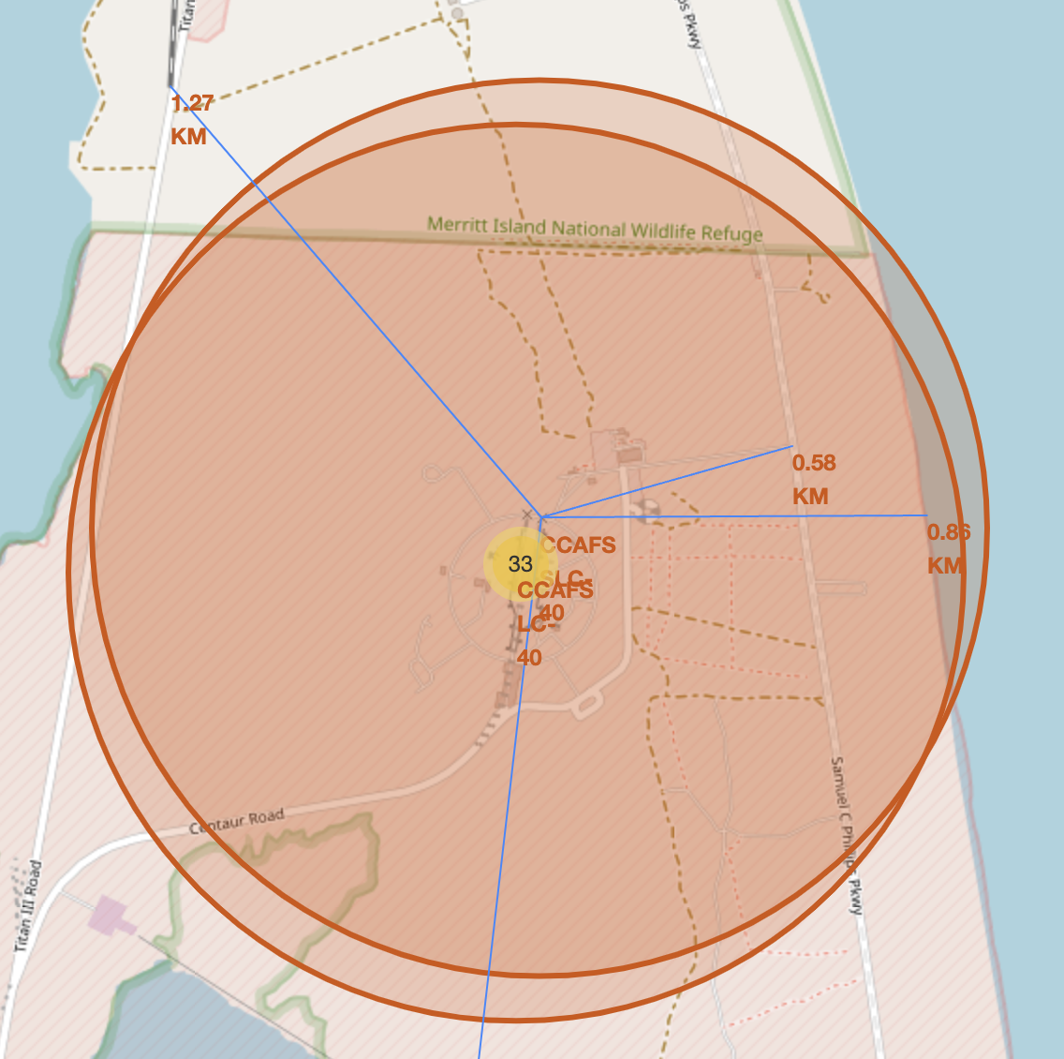
Distance Between Launch Site and Proximities
Launch Site CCAFS LC-40 and CCAFS SLC-40:
Both of these launch sites are at the same location and less than 1.5 km away from a railroad, highway and coastline.
The closest city is Melbourne at a higher distance of 51.2 km.

Slide 39
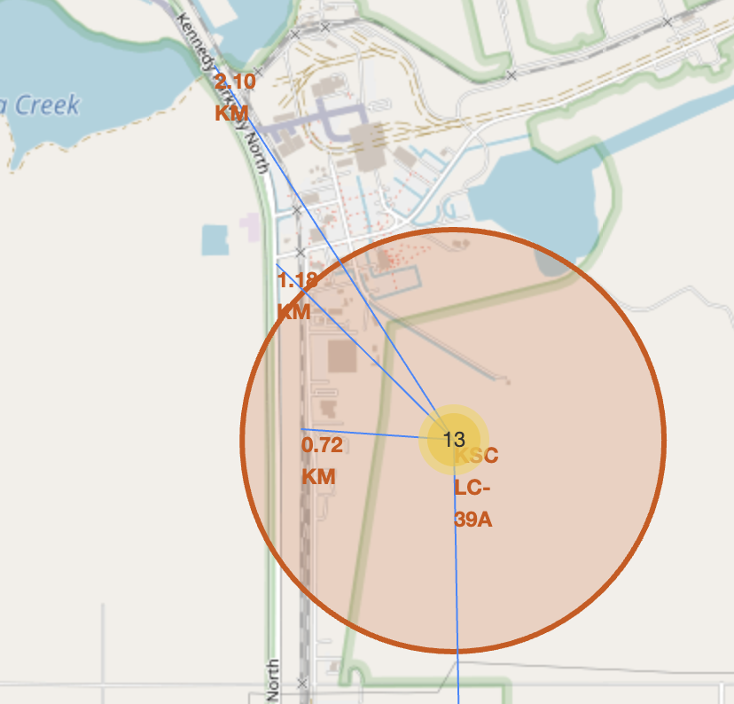
Distance Between Launch Site and Proximities
Launch Site KSC LC-39A:
This launch site is also in Florida and has less than 2.5 km from a railroad, highway and coastline, maintaining the previous slides pattern.
The closest city is also Melbourne at a higher distance of 51.96 km.

Slide 40
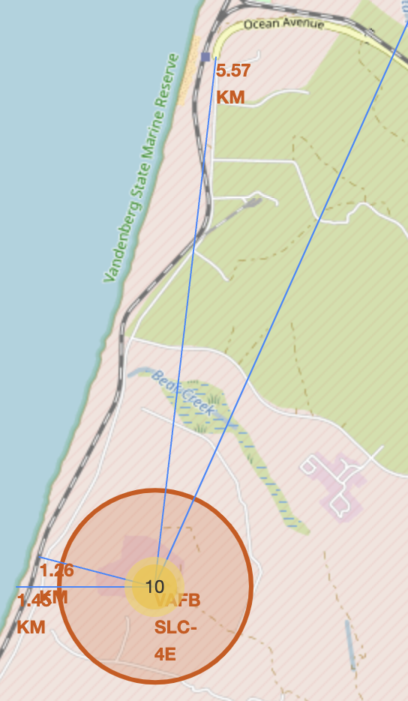
Distance Between Launch Site and Proximities
Launch Site VAFB SLC-4E in California:
This launch site has less than 5.6 km from a railroad, highway and coastline.
The nearest city is Santa Maria at 38.94 km.
We see a repeatable pattern in all launch sites: they are close to railroads, highways and coastlines, and further away from big cities.

Slide 41


Slide 42
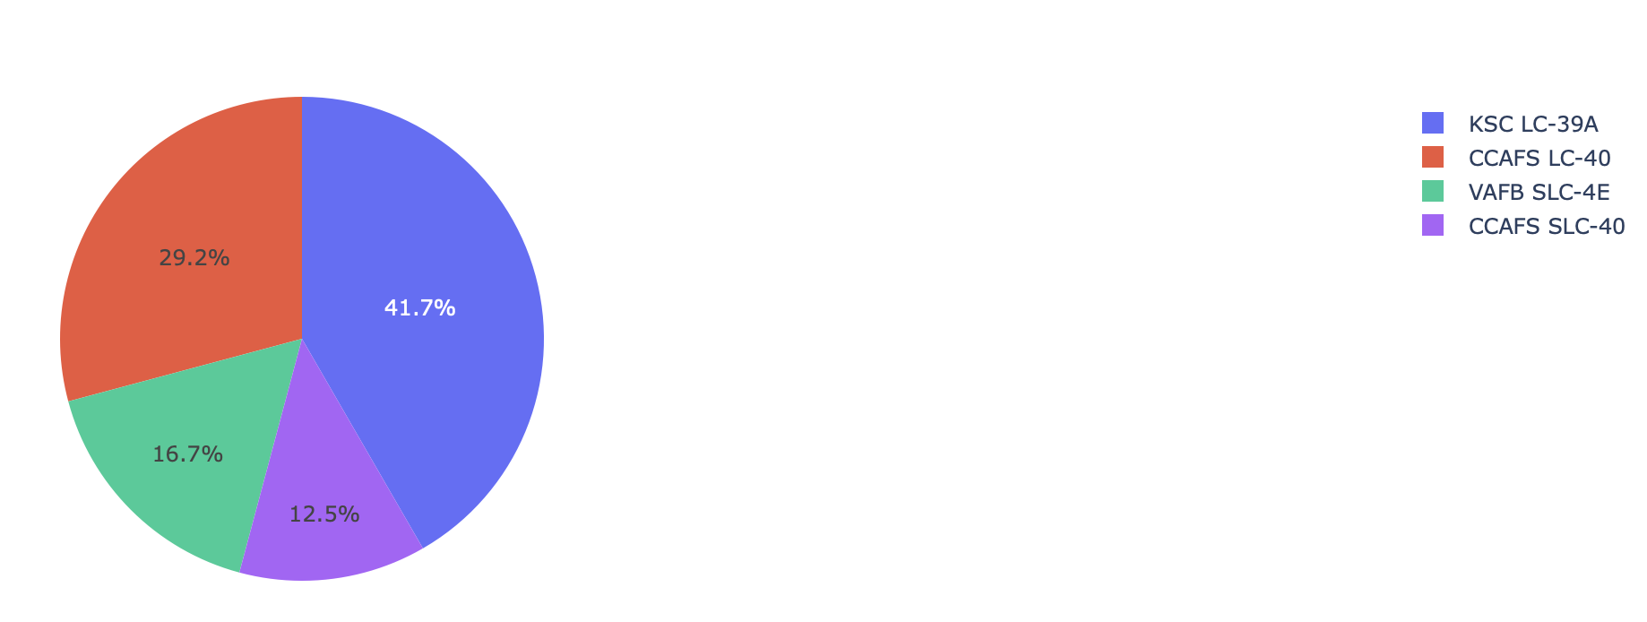
Successful Launches per location
We see how KSC LC-39A has the most successful Launches.

Slide 43
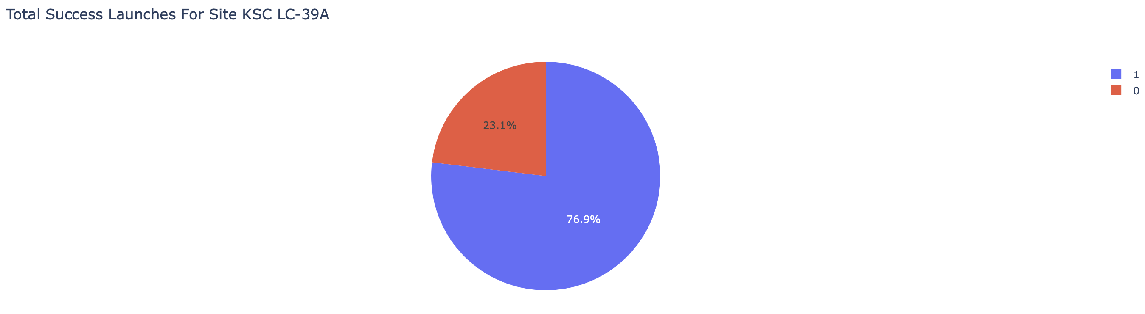
Launch Success Ratio of KSC LC-39A
We see how KSC LC-39A has the most successful launch rate, with a success rate of 76.9%, since it also has the most launches it means that this site probably has a higher chance of success.

Slide 44
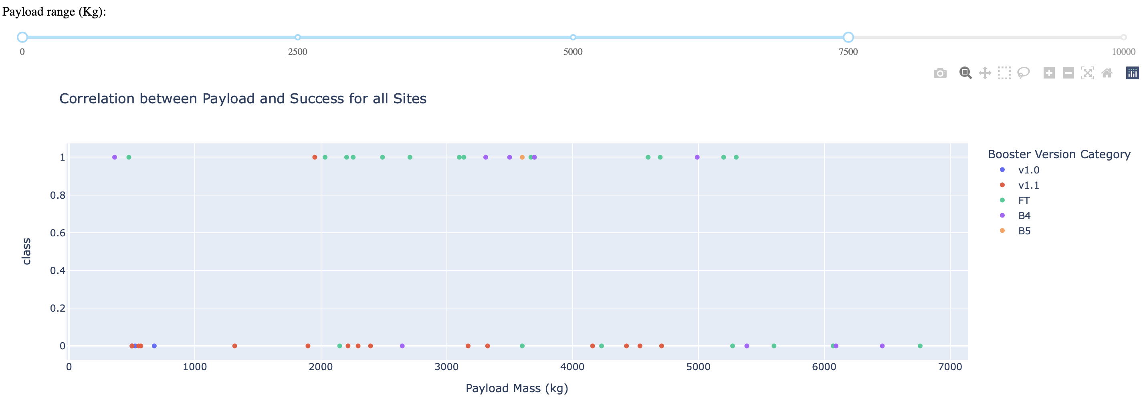
Payload and Success Scatter Plot
The range was reduced to 7500 kg for better visualization. We see v1.1 has seldom worked. FT is the most successful Booster Version Category.

Slide 45


Slide 46
Classification Accuracy
All models had different performances when selecting hyperparameters via a Grid Search, nevertheless on the test set we see that all models with their best hyperparameters had the same accuracy, meaning no model performed better than the other.

Slide 47
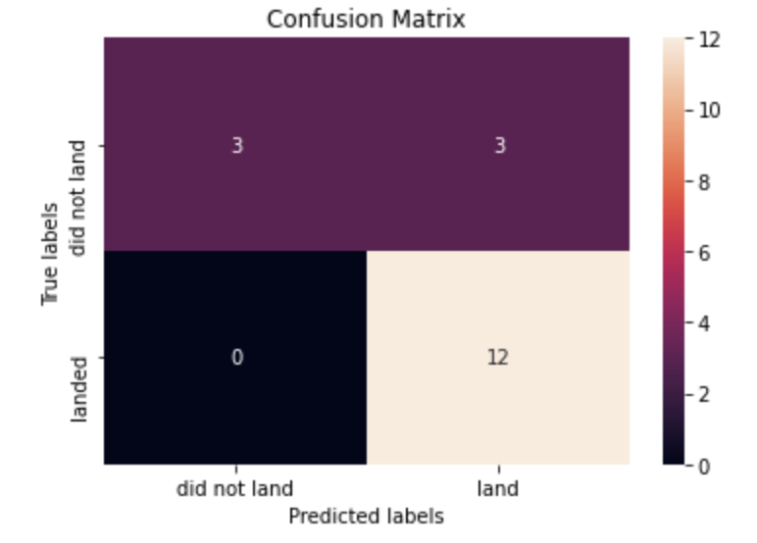
Confusion Matrix
Since all models have equal performance, the confusion matrix is the same for all.
We see that there is a problem with false positives, meaning that the model predicts that it will land and it doesn’t do so.

Slide 48
Conclusions
EDA was a useful tool to recognize the important variables for the model.
An accuracy of 83.33% proves the success of classification models to predict success outcome.
The confusion matrix shows that prediction errors fall on the False Positive prediction, this will have an effect of overestimating the cost of future launches.
Since all models have the same accuracy, the best model to choose would be the most efficient one, making Logistic Regression the most convenient model to select.

Slide 49
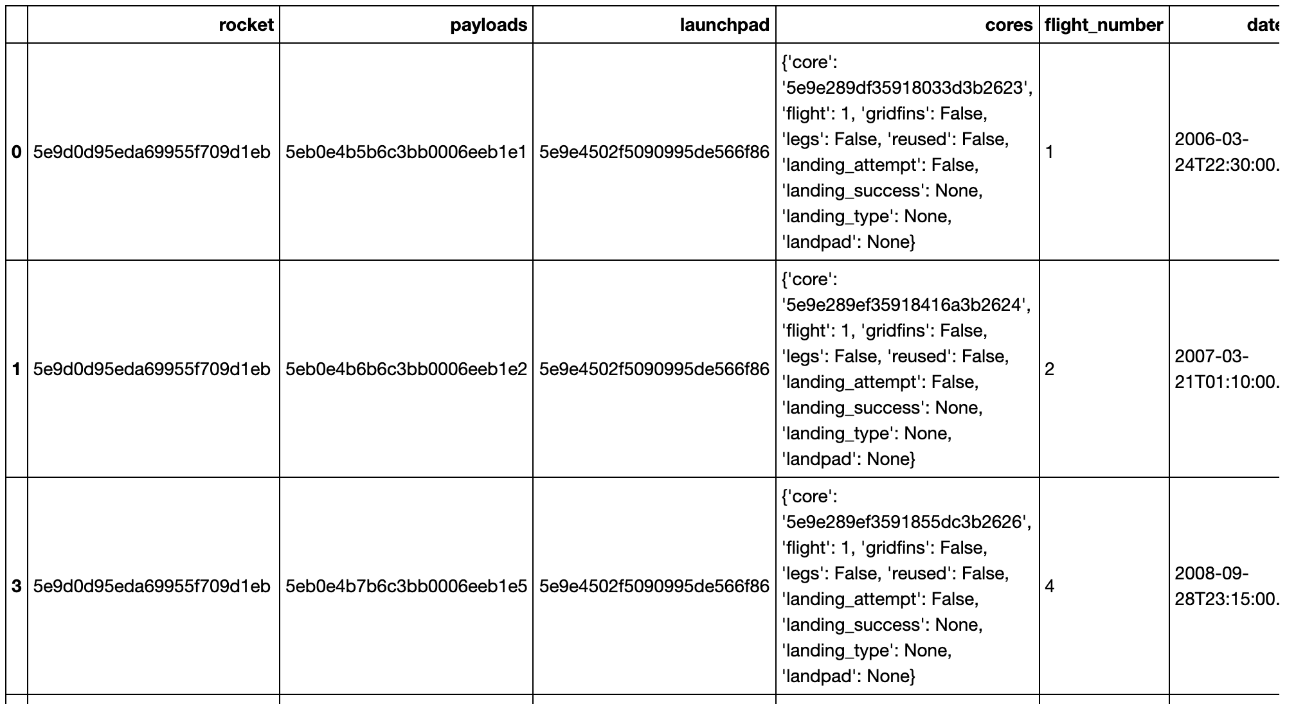
Appendix
Initial data obtained through the SpaceX API

Slide 50
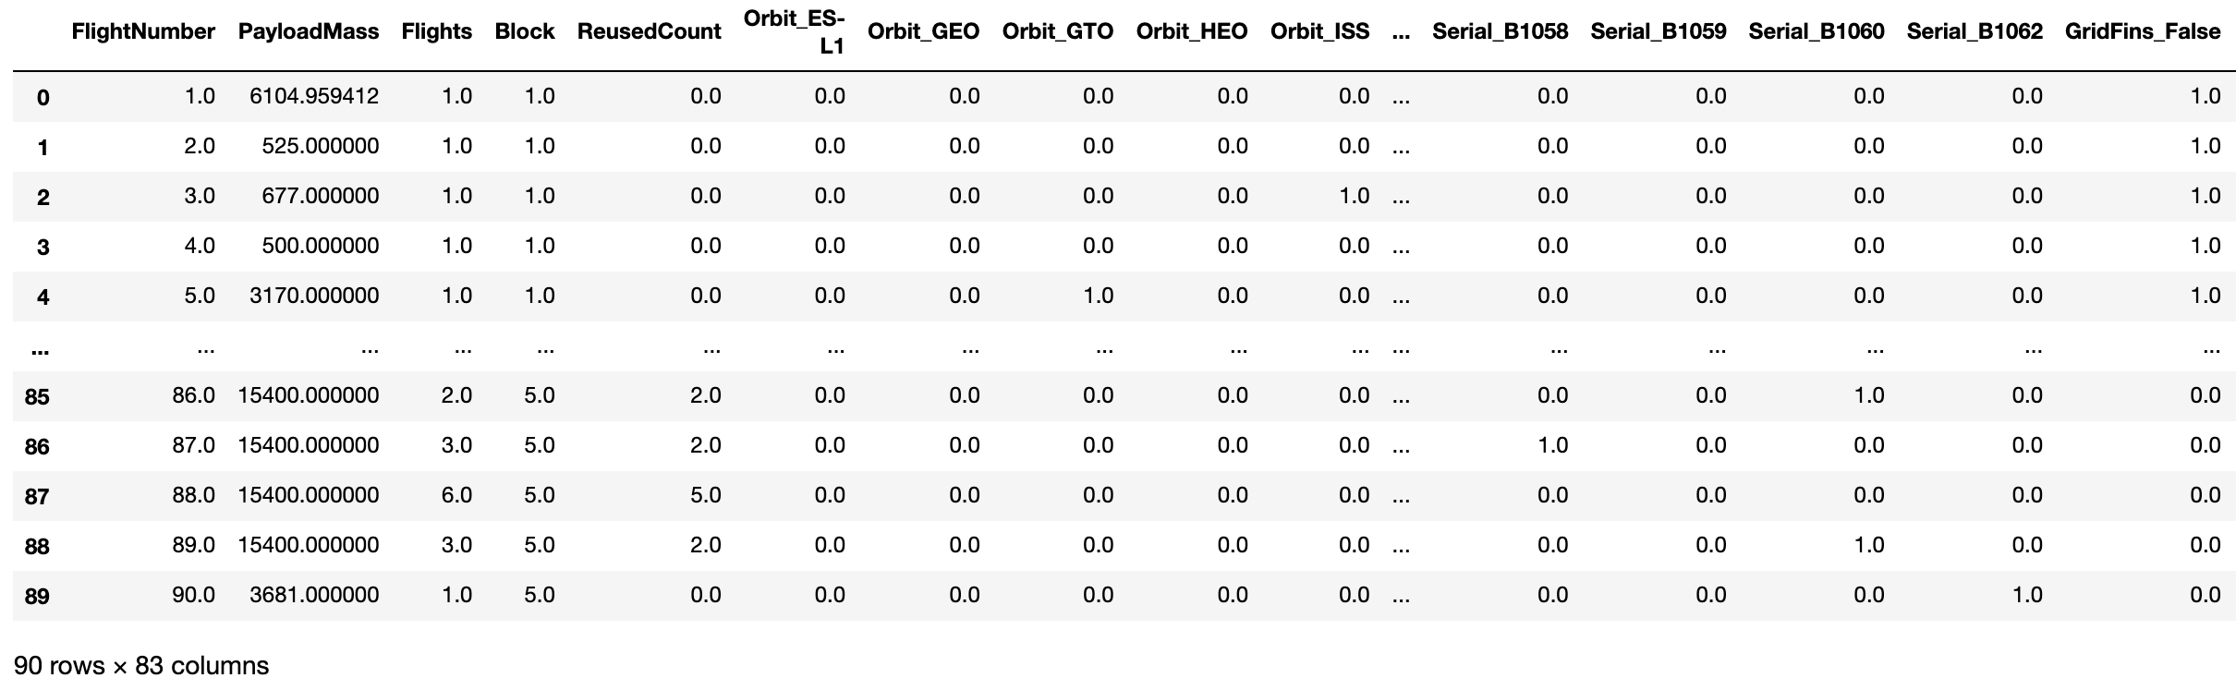
Appendix
Final Dataframe of Independent Variables before normalization

Slide 51
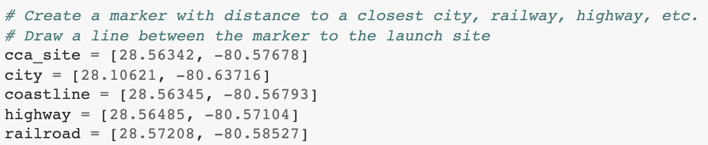
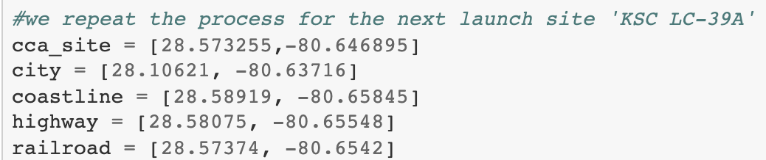
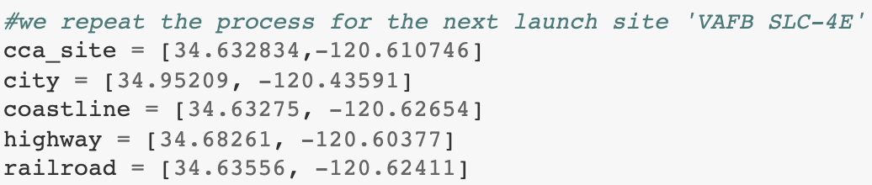
Appendix
Folium coordinates used of nearest points to launch sites:

Slide 52


